Slide 1
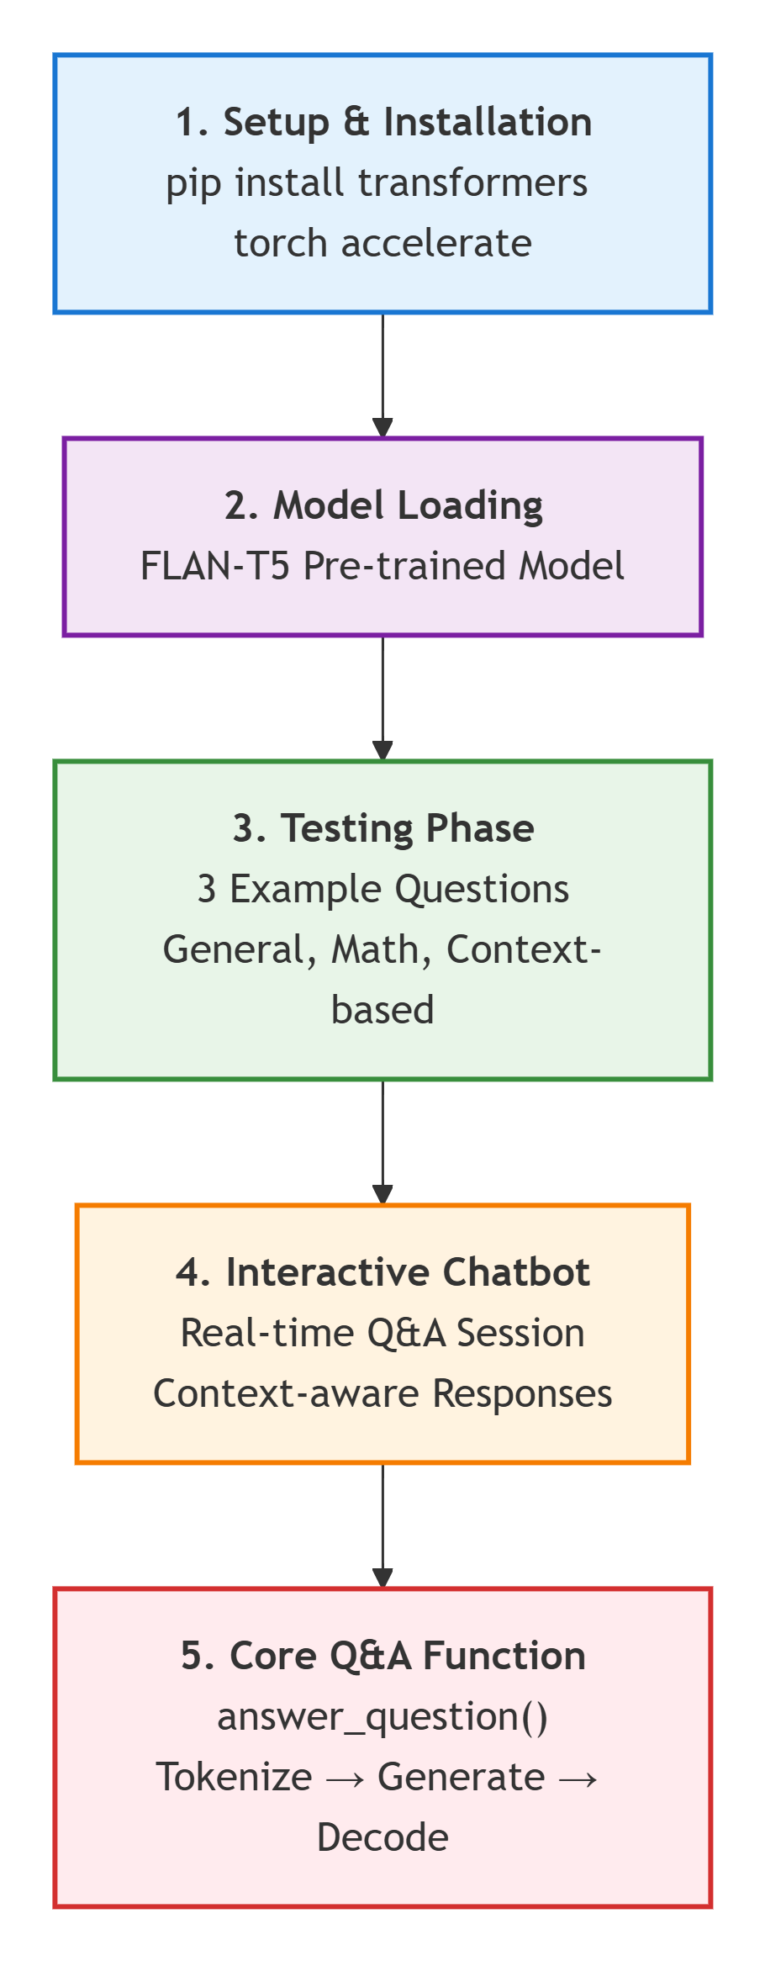

Slide 2
Feature | FLAN-T5 | DistilBERT (SQuAD) | GPT-2 | BERT | T5 | BART
Model Size (Base) | 250M params | 66M params | 124M params | 110M params | 220M params | 140M params
Type | Seq2Seq | Encoder-only | Decoder-only | Encoder-only | Seq2Seq | Seq2Seq
Primary Use | Instruction following | Extractive Q&A | Text generation | Understanding | Text-to-text | Summarization/Generation
Requires Context? | ❌ No (Optional) | ✅ Yes (Required) | ❌ No | ✅ Yes (Required) | ❌ No (Optional) | ❌ No (Optional)
Open-Domain Q&A | ⭐⭐⭐⭐⭐ Excellent | ⭐⭐ Poor | ⭐⭐⭐ Good | ⭐⭐ Poor | ⭐⭐⭐⭐ Very Good | ⭐⭐⭐⭐ Very Good
Context-Based Q&A | ⭐⭐⭐⭐⭐ Excellent | ⭐⭐⭐⭐⭐ Excellent | ⭐⭐⭐ Good | ⭐⭐⭐⭐⭐ Excellent | ⭐⭐⭐⭐ Very Good | ⭐⭐⭐⭐ Very Good
Conversational | ⭐⭐⭐⭐ Very Good | ⭐⭐ Poor | ⭐⭐⭐⭐⭐ Excellent | ⭐ Very Poor | ⭐⭐⭐ Good | ⭐⭐⭐⭐ Very Good
Factual Accuracy | ⭐⭐⭐⭐⭐ Excellent | ⭐⭐⭐⭐⭐ Excellent | ⭐⭐⭐ Good | ⭐⭐⭐⭐ Very Good | ⭐⭐⭐⭐ Very Good | ⭐⭐⭐⭐ Very Good
Speed (Inference) | ⭐⭐⭐ Medium | ⭐⭐⭐⭐⭐ Very Fast | ⭐⭐⭐⭐ Fast | ⭐⭐⭐⭐⭐ Very Fast | ⭐⭐⭐ Medium | ⭐⭐⭐ Medium
Memory Usage | ~1.5 GB | ~500 MB | ~700 MB | ~600 MB | ~1.3 GB | ~800 MB
Colab Free Tier | ✅ Works Great | ✅ Works Great | ✅ Works Great | ✅ Works Great | ✅ Works Great | ✅ Works Great
Setup Difficulty | ⭐ Very Easy | ⭐⭐ Easy | ⭐ Very Easy | ⭐⭐ Easy | ⭐⭐ Easy | ⭐⭐ Easy
Training Data | 1.8T tokens | SQuAD dataset | WebText | BookCorpus + Wikipedia | C4 dataset | News + Books
Release Year | 2022 | 2019 | 2019 | 2018 | 2020 | 2019
Output Format | Natural text | Extracted span | Generated text | Classification | Natural text | Natural text
Creativity | ⭐⭐⭐ Moderate | ⭐ Very Low | ⭐⭐⭐⭐⭐ Very High | ⭐ Very Low | ⭐⭐⭐ Moderate | ⭐⭐⭐⭐ High
Hallucination Risk | ⭐⭐ Low | ⭐ Very Low | ⭐⭐⭐⭐ High | ⭐ Very Low | ⭐⭐ Low | ⭐⭐⭐ Medium

